Slide 1
Library Database Design : Relational Model
Team Members : Mohamed Shaker, Sirin Blan, Omar Elqadi, Ahmad Jebril, Daniel Morley
Course : 3160 Database Design and Implementation
Professor : Azhar Ahamad
Date : November 17, 2024

Slide 2

Project Overview
The Library Database is a relational database designed to efficiently implement and manage book rentals, member information, and plenty of other catalog details. It’s main objective is to maintain accurate relationships between books, genres, authors, library members, and rental records.
Objectives / Scope
Organize Library data, including books, authors, genres, titles, and availability
Books : details like title and publication year
Members : Stores details, such as name and contact information
Authors : structured data for author and genre details.
Genre : Categorizes books by genre for better organization.
Rented_Book: Keeps track of rental details, including which books are rented by different members.

Slide 3
Requirement Gathering
Data Requirements
Functional Requirements
The member can view the catalog and see the amount of copies left, or search the book by genre or author. The librarian can view what each member rented out.
Book | Author | Genre | Member | Rented_Book
book_id (PK) | author_id (PK) | genre_id (PK) | member_id (PK) | rental_id (PK)
book_title | first_name | genre_name | first_name | book_id (FK)
author_id (FK) | last_name | fiction_type | last_name | member_id (FK)
genre_id (FK) |  |  | email | rental_date
publication_year |  |  | phone_number | due_date
available_copies

Slide 4
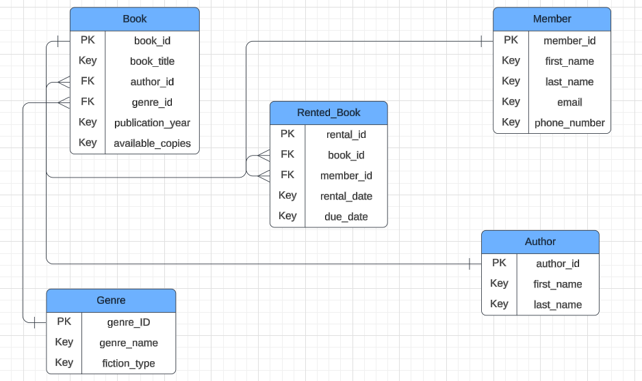
ER Diagram

Slide 5
Conceptual Design Explanation
Core Entities - Attributes
Book: book_id (PK), book_title (Key), author_id (FK), genre_id (FK), publication_year (Key), available_copies (Key)
Author: author_id (PK), first_name (Key), last_name (Key)
Genre: genre_ID (PK), genre_name (Key), fiction_type (Key)
Member: member_id (PK), first_name (Key), last_name (Key), email (Key), phone_number (Key)
Rented_Book: rental_id (PK), book_id (FK), member_id (FK), rental_date (Key), due_date (Key)
Core Entities - Relationships
Book to Author (N:1): A book has an author
Book to Genre (N:1): A book has a genre
Book to Rented_Book (1:N): A book can be rented
Member to Rented_Book (1:N): A member can rent one or more books

Slide 6
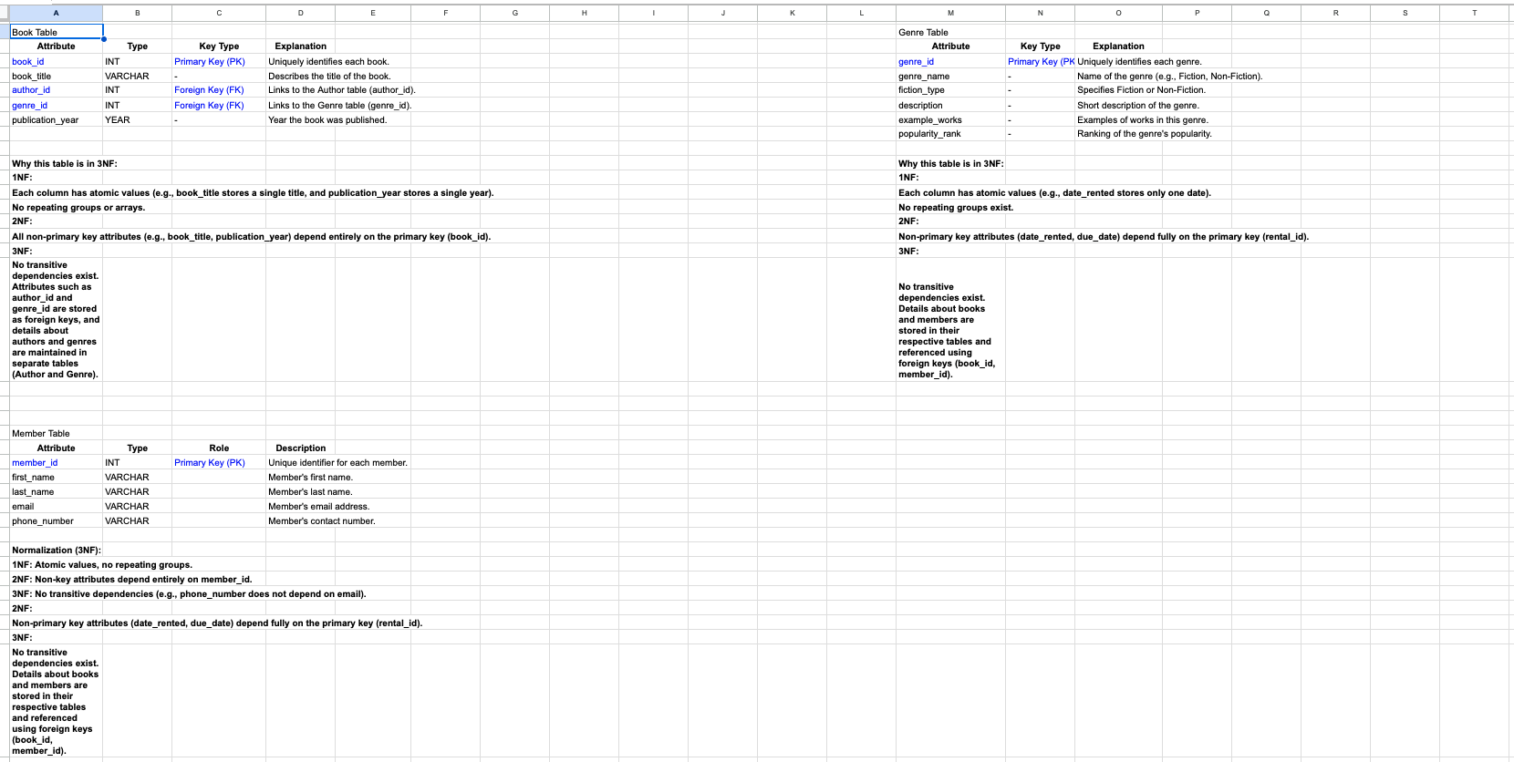
Logical Design

Slide 7
Physical Model
https://docs.google.com/document/d/1MNk2jfkmLJm6t5C0cpaPCmFiti_uINV581TowAchk3k/edit?tab=t.0

Slide 8
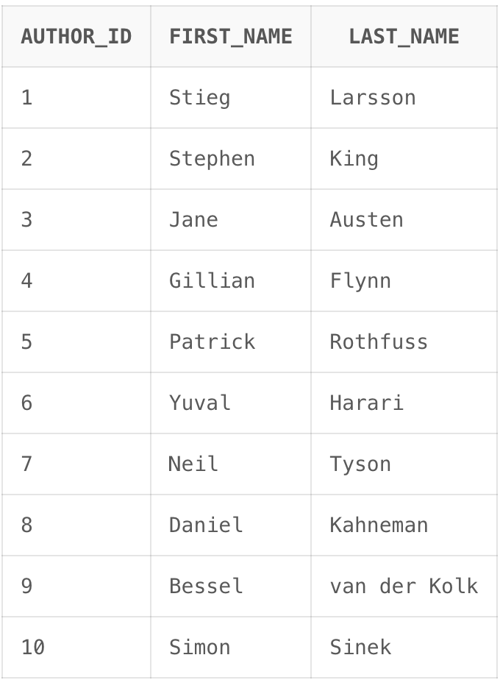
Author’s table
CREATE TABLE author (
author_id INT PRIMARY KEY,
first_name VARCHAR2(50),
last_name VARCHAR2(50)
);

Slide 9
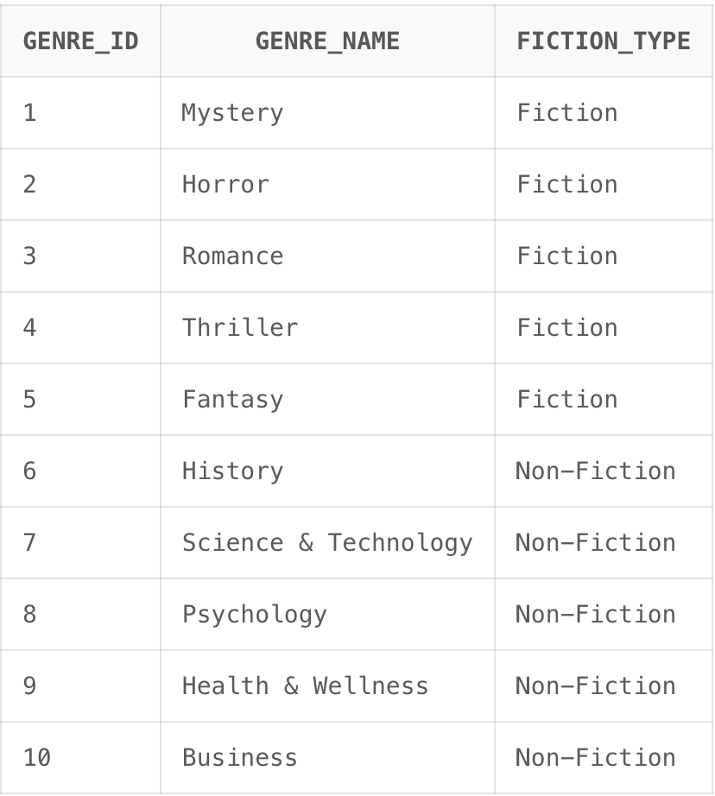
Genre’s table
CREATE TABLE genre (
genre_id INT PRIMARY KEY,
genre_name VARCHAR2(50) UNIQUE NOT NULL,
fiction_type VARCHAR2(50)
);

Slide 10
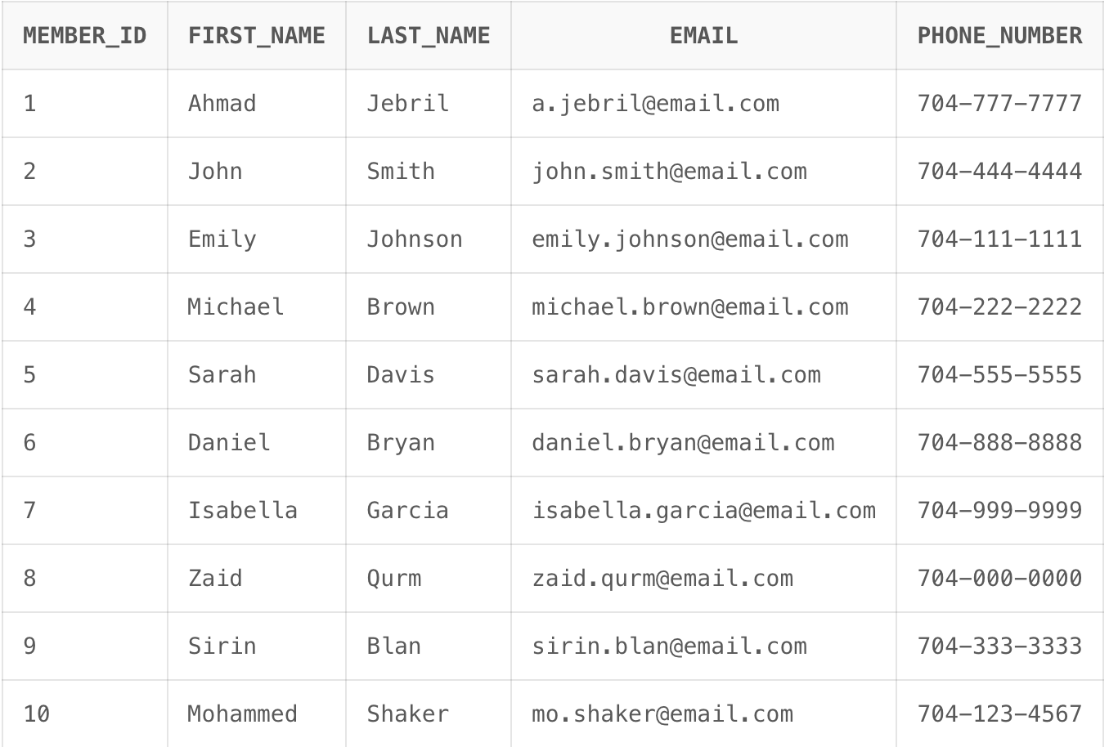
Member’s table
CREATE TABLE member (
member_id INT PRIMARY KEY,
first_name VARCHAR2(50) NOT NULL,
last_name VARCHAR2(50) NOT NULL,
email VARCHAR2(100) UNIQUE NOT NULL,
phone_number VARCHAR2(15)
);

Slide 11
Book’s table
CREATE TABLE book (
book_id INT PRIMARY KEY,
book_title VARCHAR2(100),
author_id INT,
genre_id INT,
publication_year INT,
available_copies INT,
CONSTRAINT fk_author FOREIGN KEY (author_id) REFERENCES author(author_id),
CONSTRAINT fk_genre FOREIGN KEY (genre_id) REFERENCES genre(genre_id)
);

Slide 12
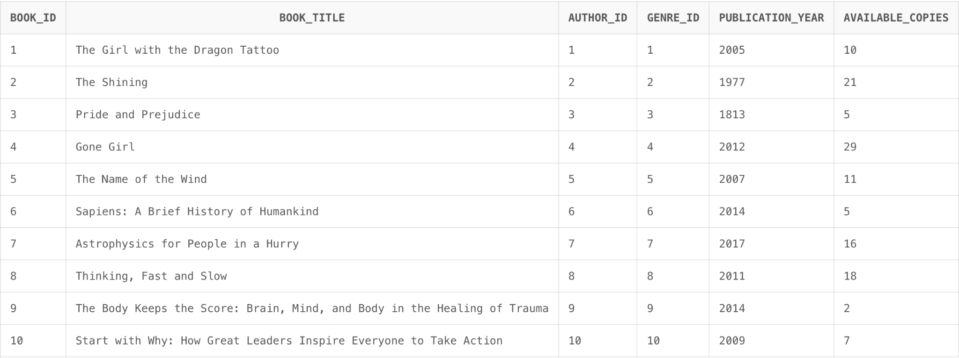
Book’s table

Slide 13
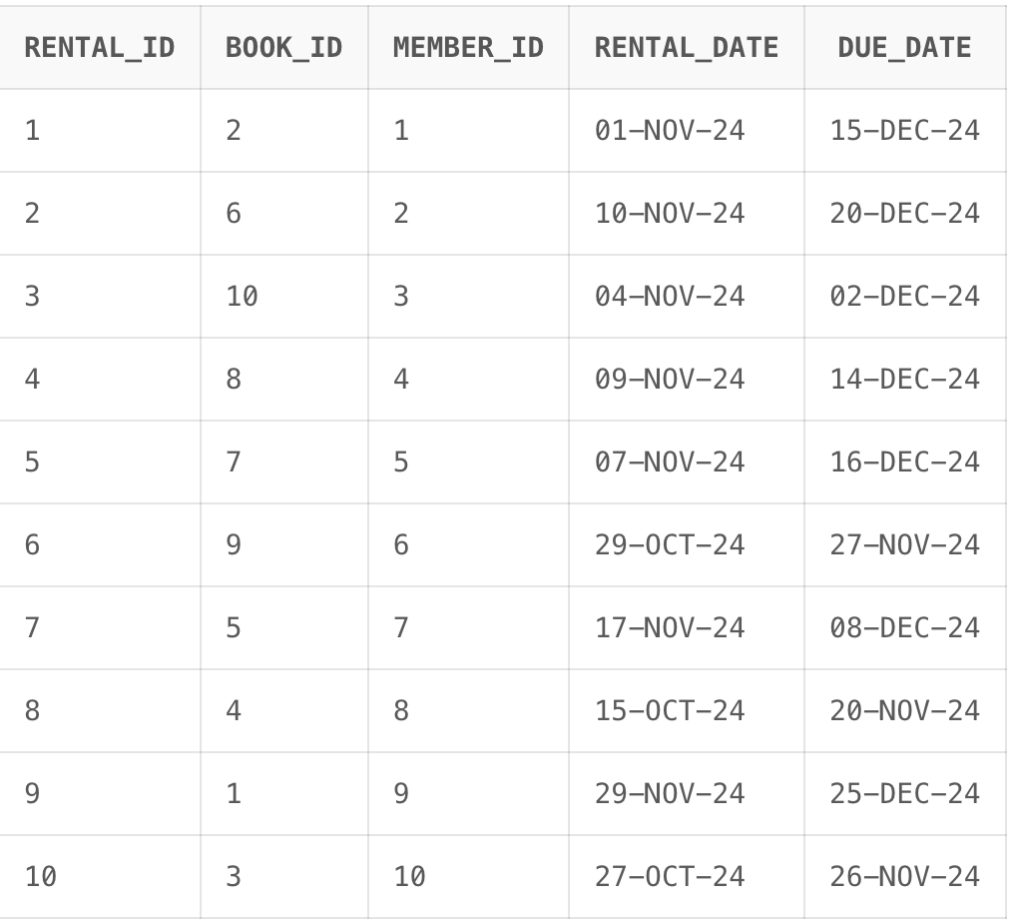
Rented book’s table
CREATE TABLE rented_book (
rental_id INT PRIMARY KEY,
book_id INT,
member_id INT,
rental_date DATE,
due_date DATE,
CONSTRAINT fk_book2 FOREIGN KEY (book_id) REFERENCES book(book_id),
CONSTRAINT fk_member2 FOREIGN KEY (member_id) REFERENCES member(member_id)
);

Slide 14
JOIN STATEMENT 1 : List of rented books, book details, and the members who rented them
CREATE VIEW rented_details AS
SELECT rb.rental_id,
b.book_title,
a.first_name ||' '|| a.last_name AS author_name,
m.first_name ||' '|| m.last_name AS member_name,
rb.rental_date,
rb.due_date
FROM rented_book rb
INNER JOIN book b
ON rb.book_id = b.book_id
INNER JOIN author a
ON b.author_id = a.author_id
INNER JOIN member m
ON rb.member_id = m.member_id;

Slide 15
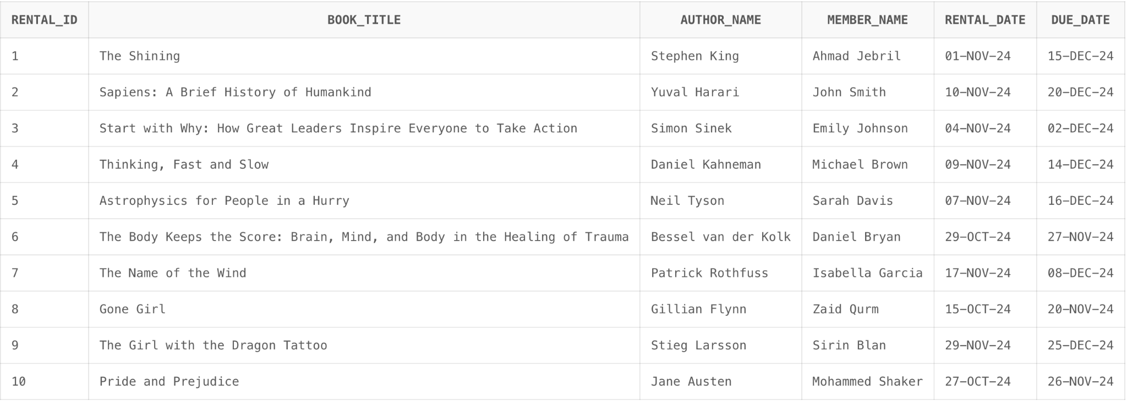
JOIN STATEMENT 1

Slide 16
JOIN STATEMENT 2 : all members and books both rented and not rented
CREATE VIEW library_book AS
SELECT m.member_id,
m.first_name || ' ' || m.last_name AS member_name,
b.book_id,
b.book_title,
rb.rental_date,
rb.due_date
FROM member m
FULL OUTER JOIN rented_book rb
ON m.member_id = rb.member_id
FULL OUTER JOIN book b
ON rb.book_id = b.book_id;

Slide 17
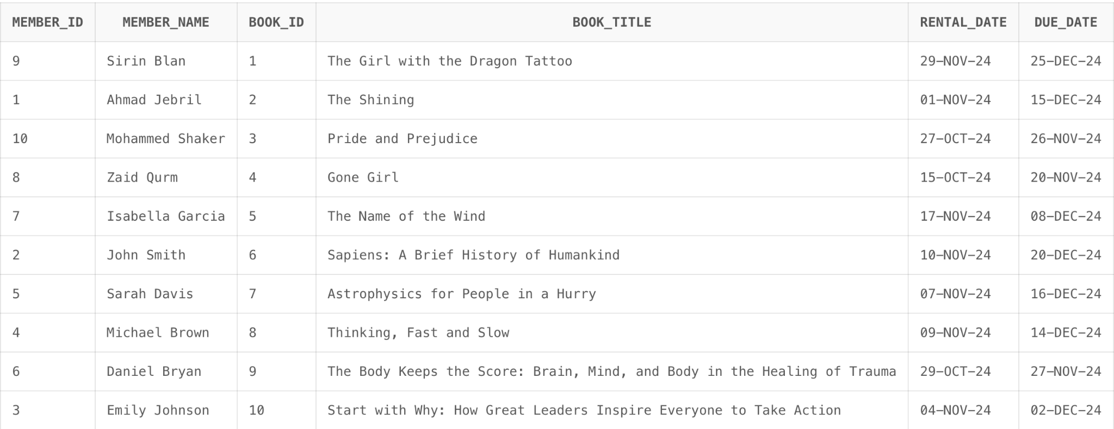
JOIN STATEMENT 2

Slide 18
JOIN STATEMENT 3 : days left until due date
CREATE VIEW books_due AS
SELECT rb.rental_id,
b.book_title,
rb.due_date,
TRUNC(rb.due_date - SYSDATE) AS days_left
FROM rented_book rb
INNER JOIN book b
ON rb.book_id = b.book_id
WHERE rb.due_date > SYSDATE
ORDER BY days_left ASC;

Slide 19
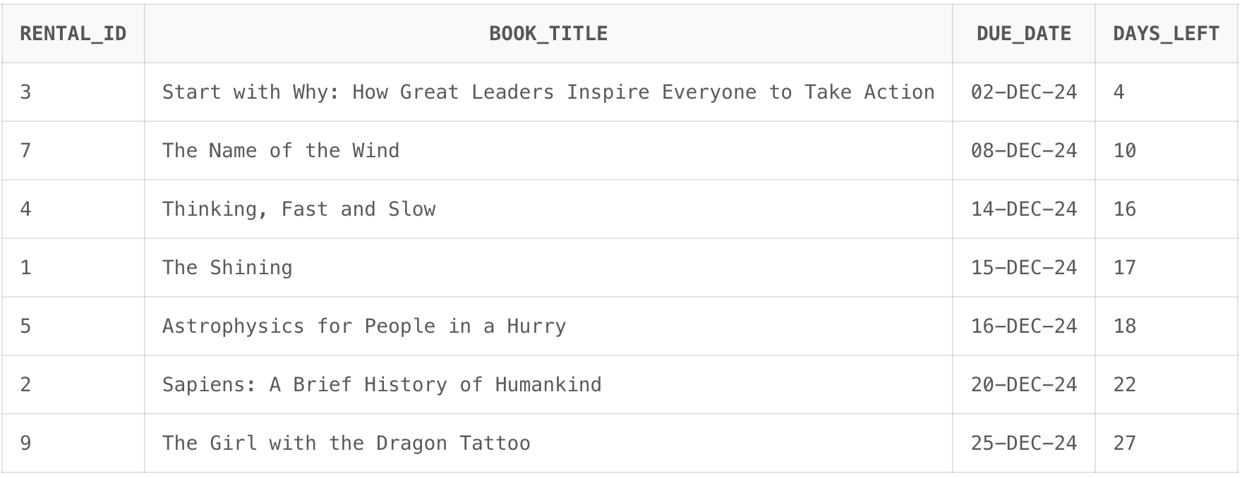
JOIN STATEMENT 3

Slide 20
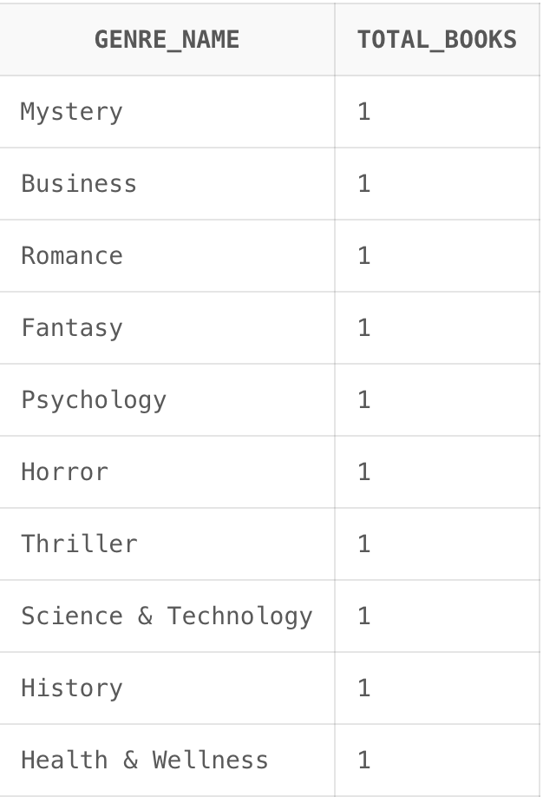
JOIN STATEMENT 4 : how many books in each genre
CREATE VIEW genre_books AS
SELECT
g.genre_name,
COUNT(b.book_id) AS total_books
FROM genre g
LEFT JOIN book b
ON g.genre_id = b.genre_id
GROUP BY g.genre_name
ORDER BY total_books DESC;

Slide 21
JOIN STATEMENT 5 : details about all the books
CREATE VIEW book_details AS
SELECT
b.book_id,
b.book_title,
a.first_name || ' ' || a.last_name AS author_name,
g.genre_name
FROM book b
INNER JOIN author a
ON b.author_id = a.author_id
INNER JOIN genre g
ON b.genre_id = g.genre_id;

Slide 22
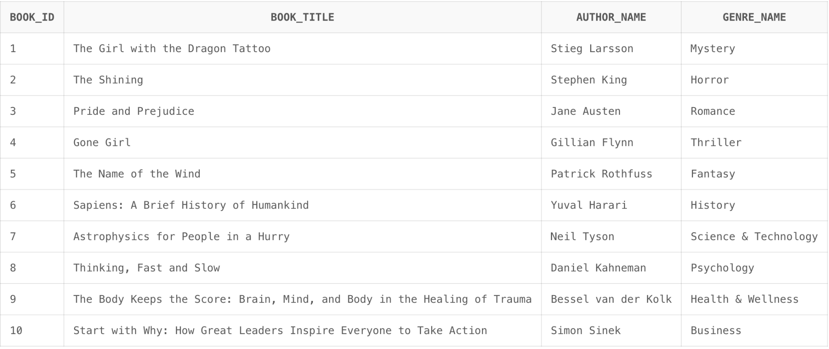
JOIN STATEMENT 5

Slide 23
Conclusion
We developed a library database model that allows a librarian to view the renting details of the books, as well as, members to browse the library database using either a book, author, or genre to find information and to rent books that are available.

